Slide 1
Intro to Programming
(for Arduino)

Slide 2
Files will be here:
github.com/tommymcdonald

Slide 3
The Arduino Language
Arduino is a set of C/C++ functions that can be compiled directly to your board via the IDE.
All standard C/C++ functions and constructs can be used in sync with the Arduino language.

Slide 4
What is C?
C is crazy. That is what.

Slide 5
Variables
What is a variable? According to wikipedia:
“Variable (computer science) In computer programming, a variable or scalar is a storage location and an associated symbolic name (an identifier) which contains some known or unknown quantity or information, a value.”

Slide 6
???
Let’s look at an example in Arduino code...

Slide 7
int led = 13; ← VARIABLE!
void setup() {
pinMode(led, OUTPUT);
}
void loop() {
digitalWrite(led, HIGH);
delay(1000);
digitalWrite(led, LOW);
delay(1000);
}

Slide 8
Change things
Hey, so you know what variables are, adjust the delays on the previous example.
1000 = 1000 ms == 1 second

Slide 9
There are several types of Variables
The most common types are:
- Int
- Float
- Double
- Bool
- Char

Slide 10
Int
Stands for “integer”, means any real (whole) number. Can be negative, just can’t be a fraction.
Fractions aren’t real.
ex. int x = 12;

Slide 11
Float
Floats just mean “floating point number”.
Simply put, a number with decimals.
ex. float x = 12.11;

Slide 12
Double
Just like a float, but bigger.
Big, huge decimals.
ex. float x = 1234452.1332231;

Slide 13
Don’t worry about this
The difference between a double and a float, is that:
Single precision (float) gives you 23 bits of significand, 8 bits of exponent, and 1 sign bit.
Double precision (double) gives you 52 bits of significand, 11 bits of exponent, and 1 sign bit.

Slide 14
Bool
“Bool” is short for “boolean”, which is a really fun way of saying “one or the other”. A boolean only has two values, true or false. Or 1 or 0, whatever you’re into.

Slide 15
Char
Char is short for “character”, and it is a representative of a 1 byte character of a-z, A-Z, and 0-9.

Slide 16
BORING
I know that was pretty boring, but let’s see what functions are and then start coding things!

Slide 17
Functions!
It’s getting real!

Slide 18
What is a function
Functions "Encapsulate" a task (they combine many instructions into a single line of code). Most programming languages provide many built in functions that would otherwise require many steps to accomplish, for example computing the square root of a number. In general, we don't care how a function does what it does, only that it "does it"!

Slide 19
Built in functions?
Setup() and Loop() are built in functions in the Arduino wrapper. They are written in C, but executed by the C compiler with Arduino.

Slide 20
Create your own program!
Create a Setup and Loop function with nothing in it! I promise you that it’s simple

Slide 21
Told you!
void setup() {
}
void loop() {
}

Slide 22
Let’s add something to that
So now we need to make something happen to our empty program...

Slide 23
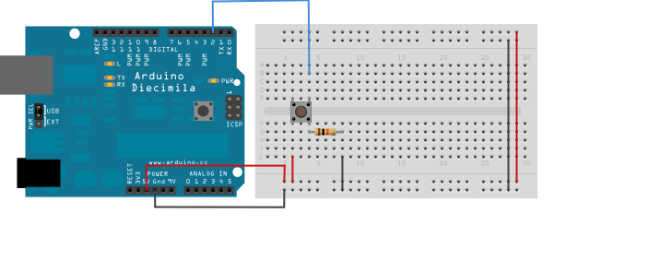
But first, setup!

Slide 24
Let’s add something to that
So now we need to make something happen to our empty program…
So let’s make it blink!

Slide 25
const int buttonPin = 2; // the number of the pushbutton pin
void setup(){
}
void loop(){
}

Slide 26
const int buttonPin = 2; // the number of the pushbutton pin
void setup(){
}
void loop(){
}
This initializes our button variable, setting the pin on which we’re outputting the button from.

Slide 27
const int buttonPin = 2; // the number of the pushbutton pin
const int ledPin = 13; // the number of the LED pin
void setup(){
}
void loop(){
}

Slide 28
const int buttonPin = 2; // the number of the pushbutton pin
const int ledPin = 13; // the number of the LED pin
void setup(){
}
void loop(){
}
This initializes our pin variable, setting the pin on the board which we’re trying to output the LED from.

Slide 29
const int buttonPin = 2; // the number of the pushbutton pin
const int ledPin = 13; // the number of the LED pin
// variables will change:
int buttonState = 0; // variable for reading the pushbutton status
void setup(){
}
void loop(){
}

Slide 30
const int buttonPin = 2; // the number of the pushbutton pin
const int ledPin = 13; // the number of the LED pin
// variables will change:
boolean buttonState = 0; // variable for reading the pushbutton status
void setup(){
}
void loop(){
}
Here we’ve set the state of our button to 0, which is “off”.

Slide 31
const int buttonPin = 2; // the number of the pushbutton pin
const int ledPin = 13; // the number of the LED pin
// variables will change:
int buttonState = 0; // variable for reading the pushbutton status
void setup(){
// initialize the LED pin as an output:
pinMode(ledPin, OUTPUT);
}
void loop(){
}

Slide 32
const int buttonPin = 2; // the number of the pushbutton pin
const int ledPin = 13; // the number of the LED pin
// variables will change:
int buttonState = 0; // variable for reading the pushbutton status
void setup(){
// initialize the LED pin as an output:
pinMode(ledPin, OUTPUT);
// initialize the pushbutton pin as an input:
pinMode(buttonPin, INPUT);
}
void loop(){
// read the state of the pushbutton value:
buttonState = digitalRead(buttonPin);
}

Slide 33
void setup(){
// initialize the LED pin as an output:
pinMode(ledPin, OUTPUT);
// initialize the pushbutton pin as an input:
pinMode(buttonPin, INPUT);
}
void loop(){
// read the state of the pushbutton value:
buttonState = digitalRead(buttonPin);
// check if the pushbutton is pressed.
// if it is, the buttonState is HIGH:
if (buttonState == HIGH) {
// turn LED on:
digitalWrite(ledPin, HIGH);
}
else {
// turn LED off:
digitalWrite(ledPin, LOW);
}
}

Slide 34
Fin

